Slide 1
TEAM UFO
ISTE 612: Information Retrieval and Text Mining
…Exploring the World Of
Declassified Government Documents…
Cory Maclauchlan, John Myers, Arivirku Thirugnanam

Slide 2
Agenda
01
02
03
04
The problem
The data
Why we developed this software
How we preprocessed and represented the data
MODELS used
results
Indexing and clustering techniques used
What we observed about the techniques
2

Slide 3
The Problem
Periodically, the US Government releases to the public large troves of declassified documents that have been requested.
These documents are all related to the same topic but vary greatly in what information they provide.
We endeavored to research if there was a way to pore through these documents in a better way to understand them more quickly.
3

Slide 4

Why develop this for this use case?
The CIA released a large cache of documents in 2021 related to UFOs to “The Black Vault” upon a Freedom of Information Act (FOIA) request.
The document collection consists of a mixture of scans of printed materials with redactions, memo posts and high-quality documents.
The documents are released without labeling or categorization of any kind.
Owing to data quality, classifying or extracting any useful information from the documents would be a tedious process to perform manually and without aid.
4

Slide 5

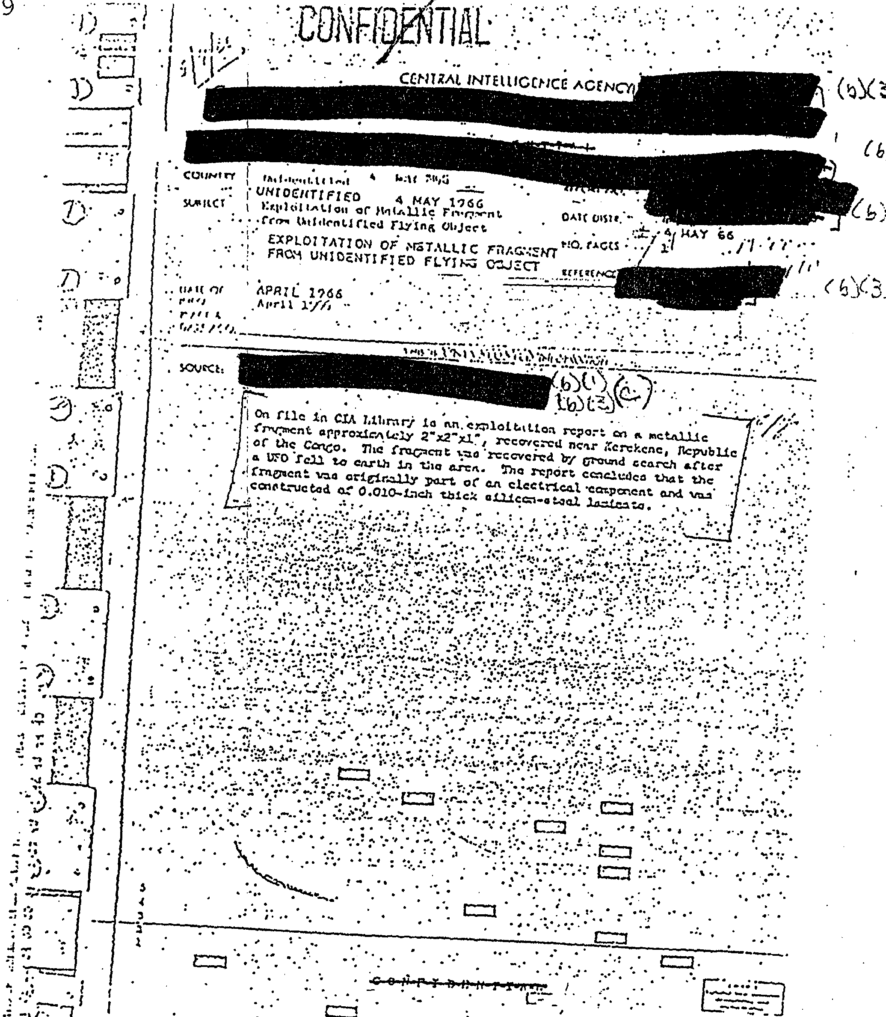
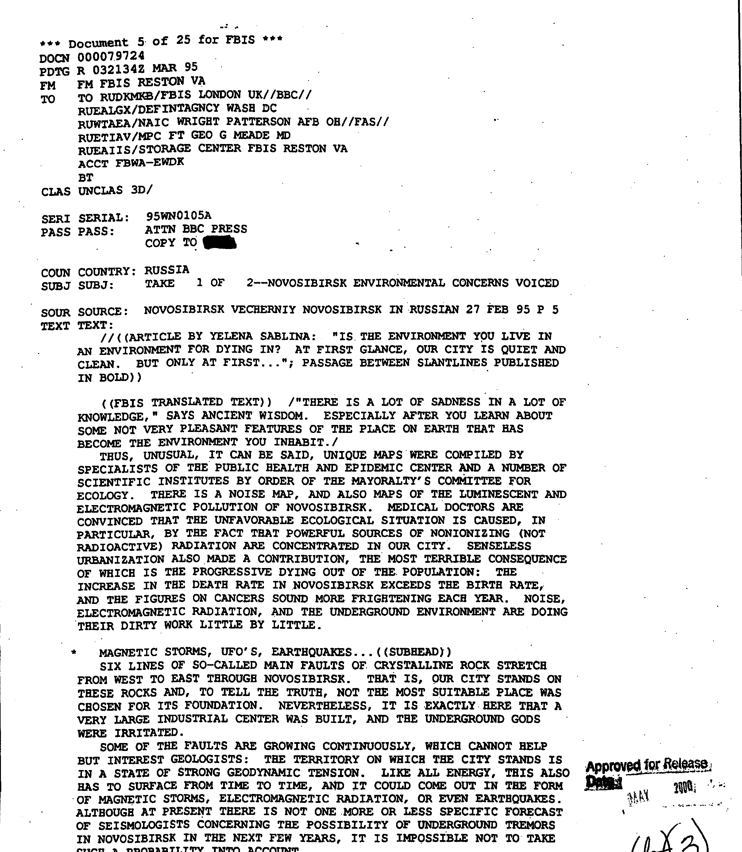
The Data
Low quality
High quality
A total of 712 PDF documents, containing 3493 pages of text related to UFOs were created from TIFF images from the CIA.
5

Slide 6
Data Preprocessing and representation
To analyze the documents, we needed to extract as much text as possible from the produced PDF documents.
We compared the extracted text from pypdf2 and pdfminer and found out that pdfminer has better efficiency and extracted more complete words.
Each PDF document is opened, the text is extracted using pdfminer, tokenized, and imported into memory.
All tokenized words are compared to a Wordnet, and only words with semantics are indexed (ie, we only use actual words in our analysis).
Only documents that have at least three words are used in this analysis.
6

Slide 7
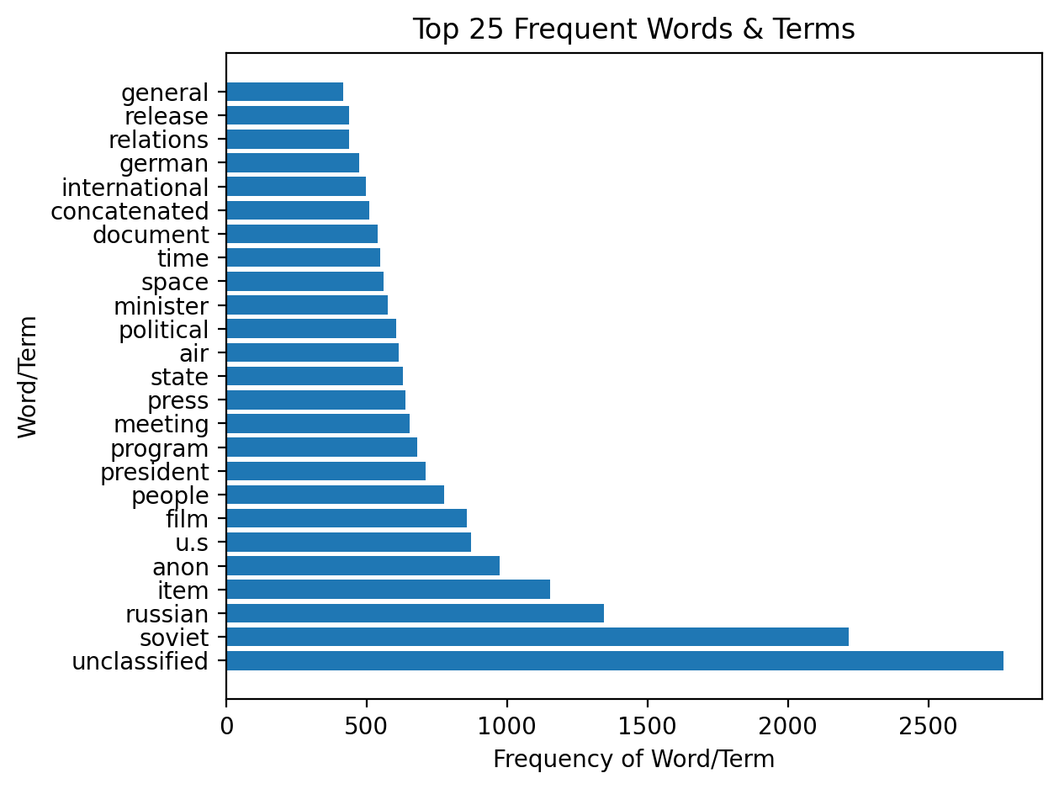
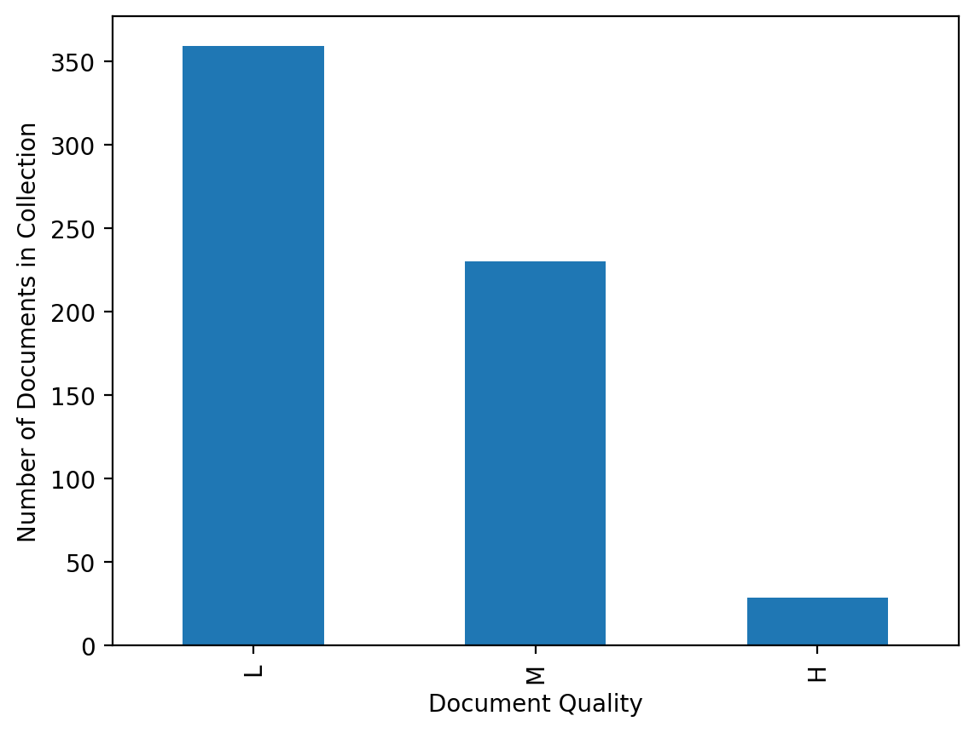
Document set Attributes
Low Quality: 359, Medium Quality: 230, High Quality: 29
Low < 100 Words
Medium < 1000 Words
High > 1000 Words
In our implementation, 144 MB of PDFs took just under five minutes to upload, parse, tokenize, categorize, and index.
There are 8205 words in the resulting dictionary.
A total of 96 documents have no useful information within them.
7

Slide 8

LEARNING and information retrieval Models Used
Learning: K-Means Clustering
Due to the nature of our unlabeled documents, a K-Means unsupervised learning model was selected in order to find interesting patterns in our data.
Resulting clusters (as well as determined ideal K-values) are used to attempt to classify documents within the application for exploration purposes.
Information retrieval: Vector Space Model
Because we want to rank results from our search, a Vector Space Model was selected to represent the documents and queries in space to improve relevant results.
Works quite well for retrieval of documents based upon queried terms and their appearances therein. Can easily be used to find similar documents in the set.
8

Slide 9
What we learned about this approach
K-Means
Vector Space Model
Requires lots of fine-tuning with aid of known centroids and classification labels.
It doesn’t work well with small size datasets and is sensitive to documents of wide-ranging sizes.
An optimal K-value must be selected and implemented by the user.
Resulting clusters may not reveal easily visible class traits.
Our documents contained infrequent non-standard words and frequent stop word candidates.
The product of term frequency and inverted document frequency (tf-idf) worked well for this class of index.
For querying, we were able to avoid common terms across all documents and length of individual documents clouding the results with noise.
9

Slide 10
RESULTS!
Here is what we observed in our exploration of this large cache of UFO documents…
10

Slide 11
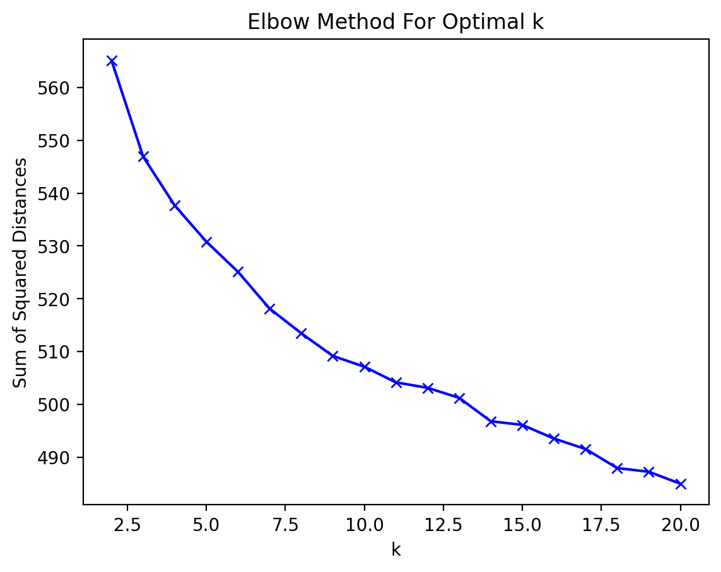
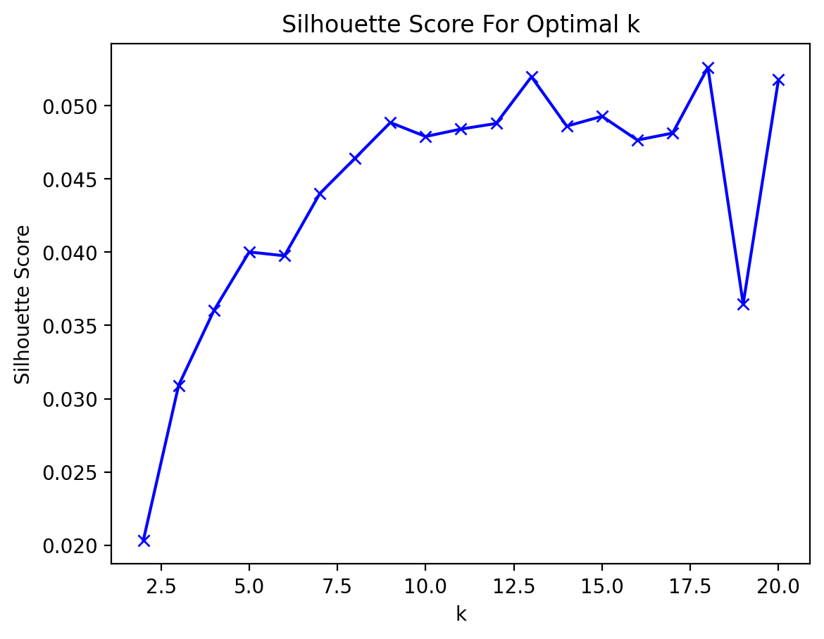
Towards a useful clustering of documents??
We chose a K-Value of 10 for our detailed analysis.
The Silhouette Scores indicate a very low confidence in the cluster assignment. This is confirmed by subsequent runs of our application often have different documents within the clusters.
11

Slide 12
K-Means Clustering data
Cluster Num | Num Docs | LowQual | Med Qual | HighQual | Avg Words | Predominant Words
1 | 54 | 2 | 37 | 15 | 839.61 | unclassified, will, soviet, people
2 | 27 | 2 | 25 | 0 | 288.07 | film, russian, cartoon, program
3 | 14 | 13 | 1 | 0 | 45.86 | object, large, meteor, light, observed
4 | 39 | 25 | 13 | 1 | 167.49 | object, reported, unidentified, sighting
5 | 44 | 31 | 12 | 1 | 146.20 | air, force, sighting, object, soviet
6 | 18 | 17 | 1 | 0 | 21.11 | dr, panel, air, project, subject
7 | 50 | 24 | 26 | 0 | 109.92 | Russian, serial, permission, incorrectly
8 | 46 | 3 | 37 | 6 | 809.46 | soviet, item, anon, meeting, russian
9 | 293 | 209 | 78 | 6 | 125.83 | unclassified, US, minister, will
10 | 33 | 33 | 0 | 0 | 17.91 | oil, tor, vas, tor, end air, lie, will, object
12

Slide 13
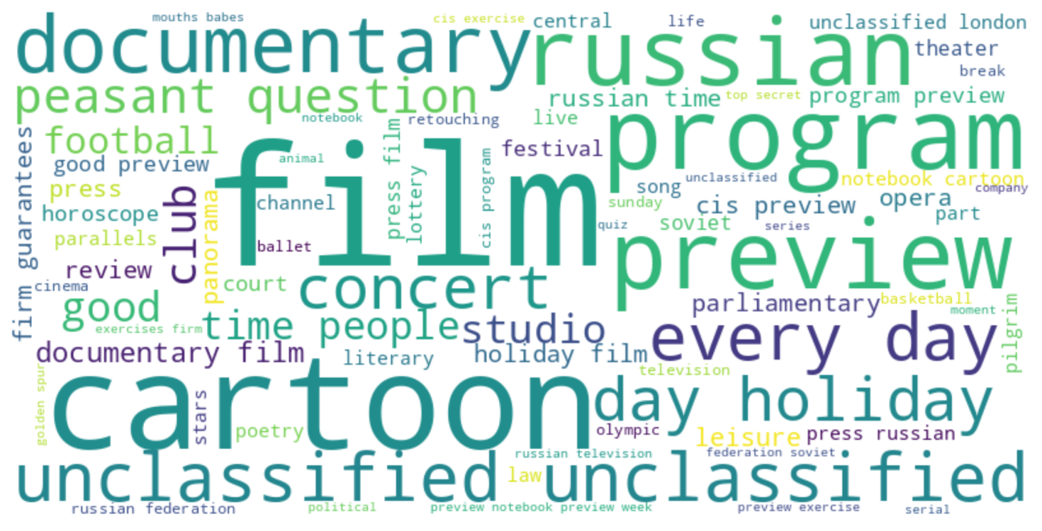
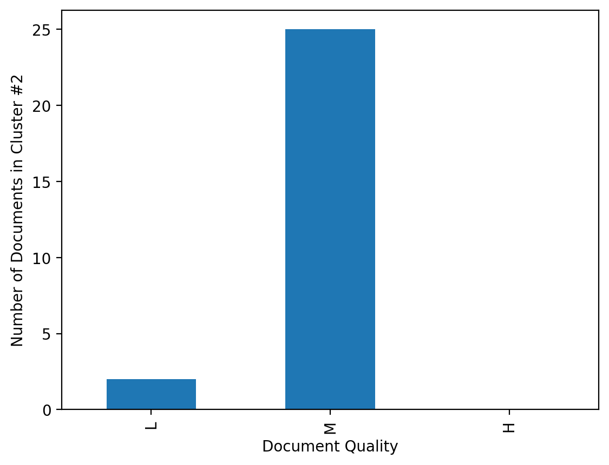
Clustering analysis
Clusters did not map to types of documents as cleanly as we hoped. There was variability in cluster content observed between runs, with a few exceptions:
One source of optimism was Cluster #2, which appeared consistently intact. All 27 PDFs of the cluster are transcripts of Russian TV programs.
Nearly all the documents are about the same size and quality, which could have affected the cluster assignment more than content.
Almost all the “High Quality” documents were in a couple of clusters together, Clusters #1, 8, and 9. Cluster #10 was composed completely of short words. This could potentially be useful feature for binning in a software application.
Important predominate phrases were observed in multiple clusters (i.e., “Unclassified,” “Air,” and “Force.”). This might indicate low cohesiveness within a cluster or help identify words with little value for this use case.
13

Slide 14
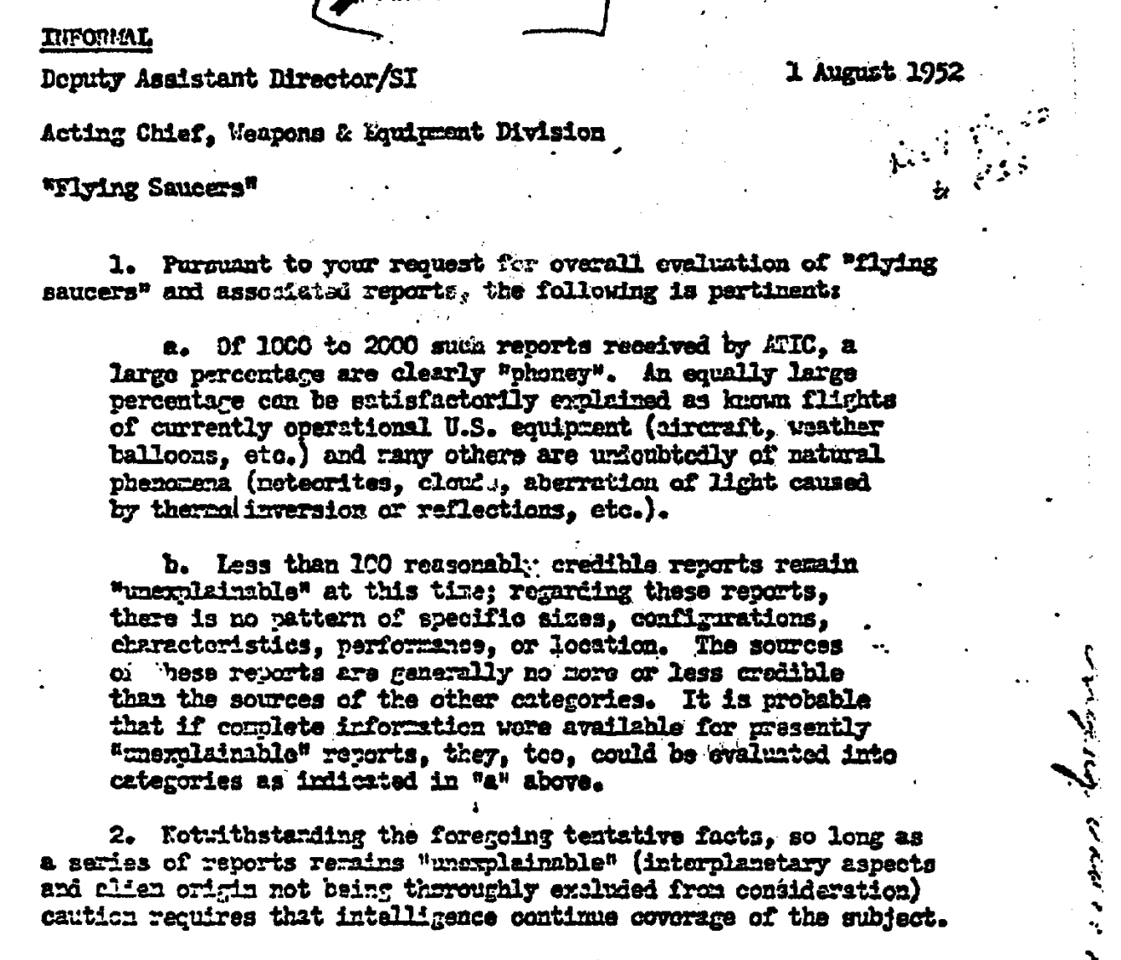
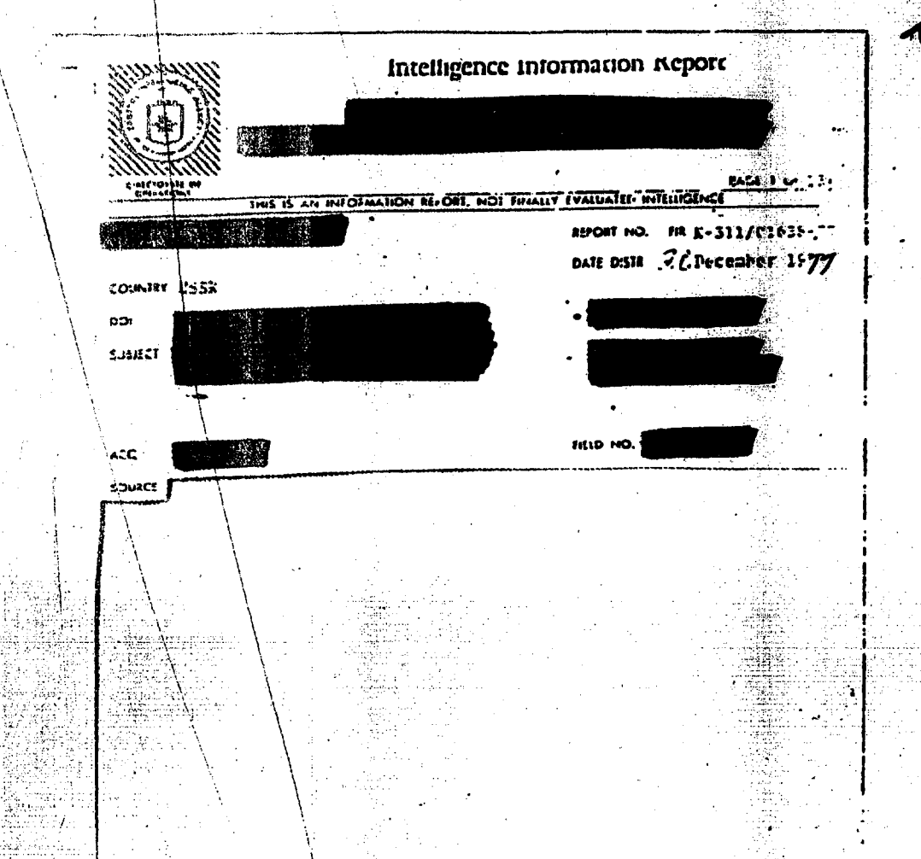
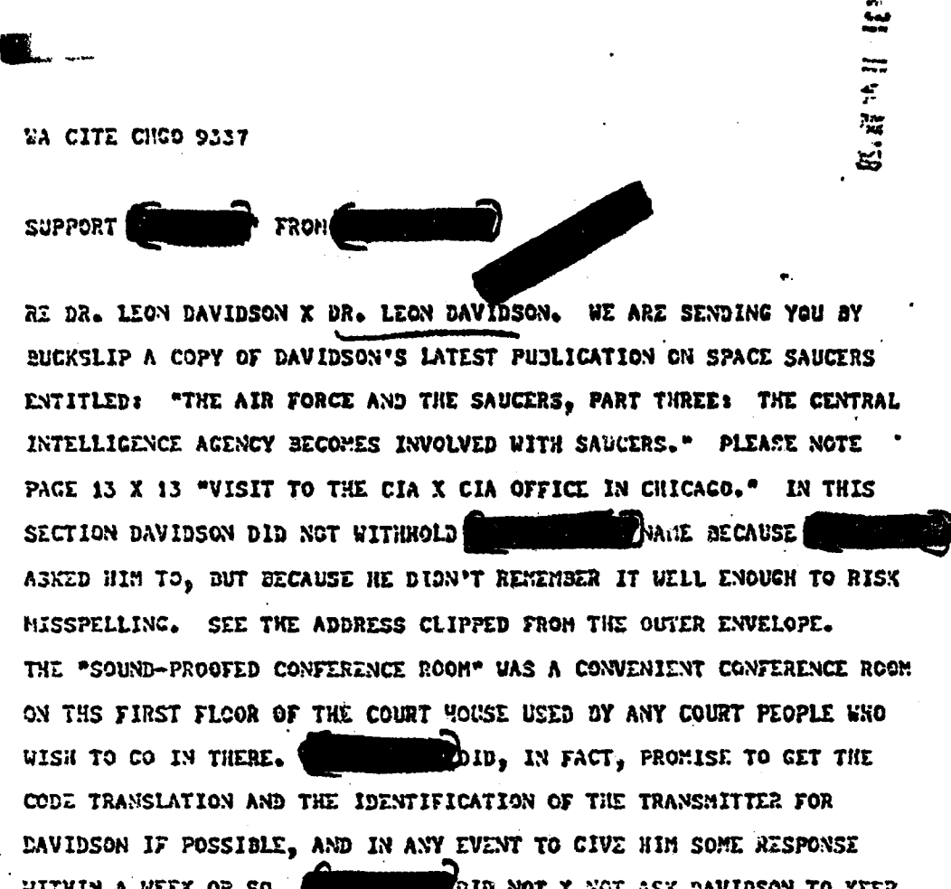
SOFTWARE ARCHITECTURE AND IMPLEMENTATION
Backend Data Subsystem
Data Processing Pipeline
PDF Converter
Feature
Vectorizer
Model Fitter
File System
Data
Conditioner
Data Processor
Model & Parameter
Admin
Specification of:
Cluster Size
Initialization Method
Iterations
Feature Extraction Method
doc3
Doc | Words
doc1 | [unclass,ufo,saucer,…]
doc2 | [intelligence,report,…]
doc3 | [weapons,equipment,…]
Cluster Data
doc2
doc1
…
Plots
Rendering
Display of:
Optimal Cluster Graph
K-Means Clusters
Word Cloud
Profile of Documents
Streamlit app
Visualization Subsystem
14

Slide 15



Software FEATURES
 | Process | Upload a set of PDF documents, track their progress through preprocessing, and view basic statistics on their contents.
 | Query | Pass a query string to the VSM and retrieve a specified number of results back from the index, along with the context in the document.
 | Explore | View statistics on SSE and Silhouette Scores for K-Values from 2-20, user can select one, and view cluster data as returned from K-Means algorithm.
15

Slide 16
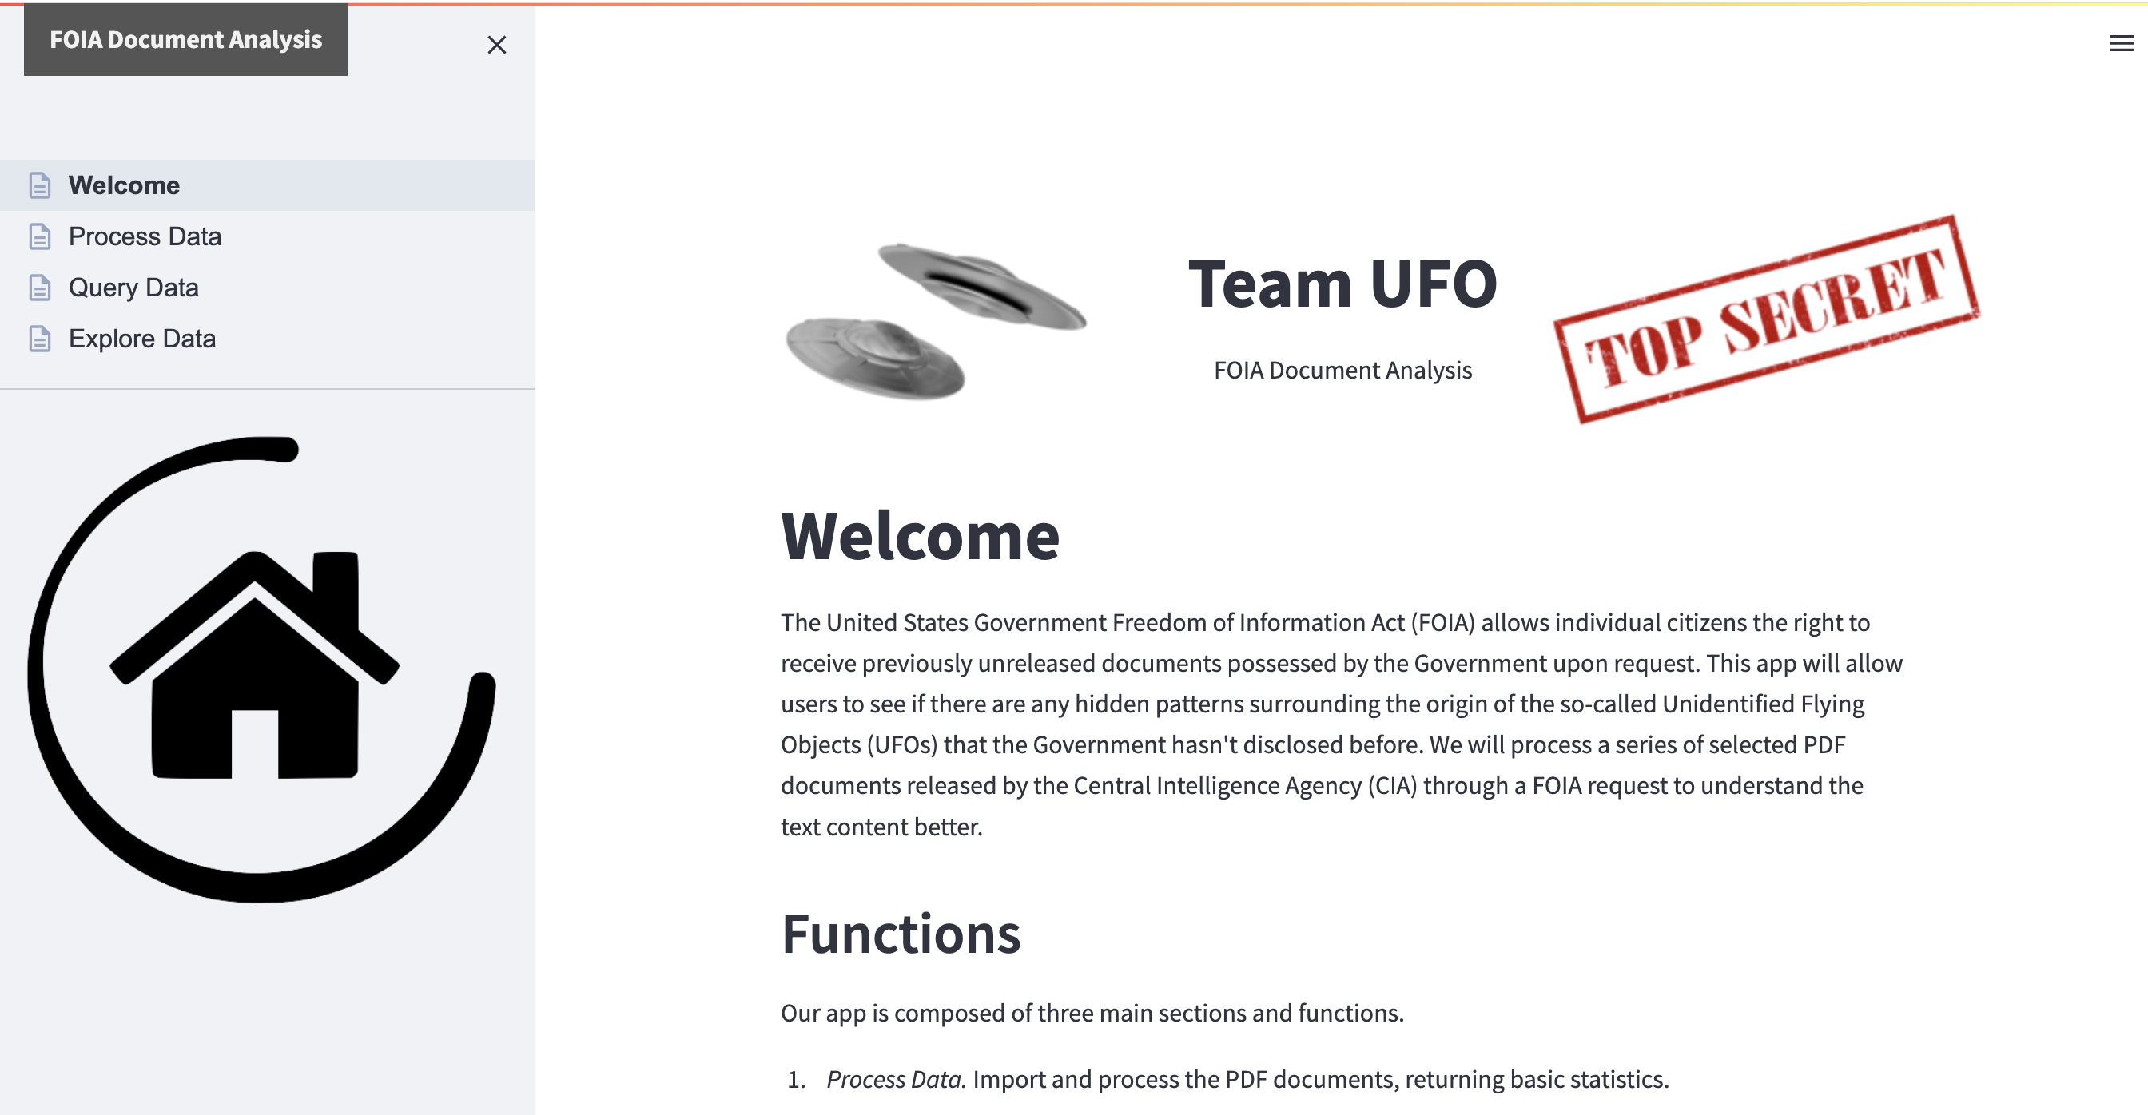
SOFTWARE DEMO
Our Python application, based upon a Streamlit application stack, is available on GitHub at: https://github.com/johnemyers/iste-612/
16

Slide 17
THANK YOU! QUESTIONS?
17

